Slide 1
NAO-Kinect Teleoperation
Brady Rainey, Jill Mercer

Slide 2
Overview
Motivation
Java 4 Kinect Library
Skeleton Angles
NAO Angles
Summary
Future Work
Questions

Slide 3

Motivation
Challenging project in an interesting area of research.
Physical component.

Slide 4
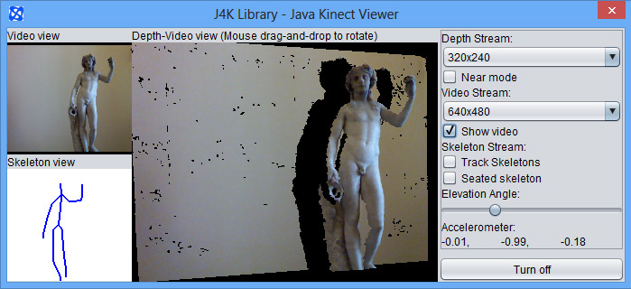
Java for Kinect (J4K) Library
Provides Skeleton
Array of joints which include X, Y, Z positions

Slide 5
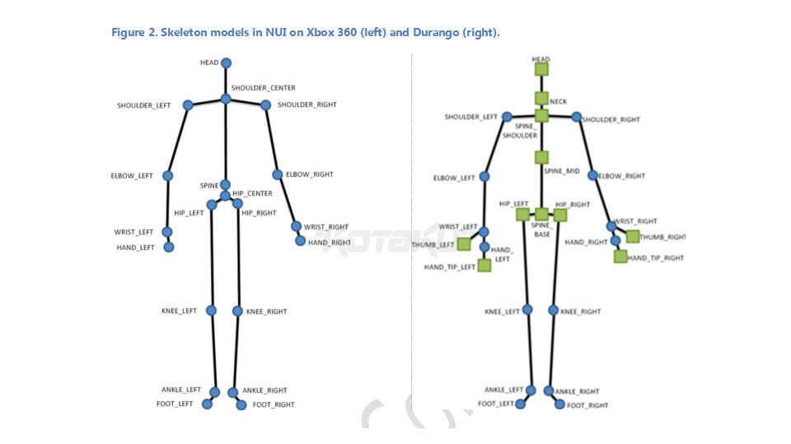
Skeleton Angles
Two Methods:
Slope for Shoulder Pitch: elbow, shoulder
Vectors for Shoulder/Elbow Roll (3 points)
Allow for a correction angle
Negate for right side

Slide 6
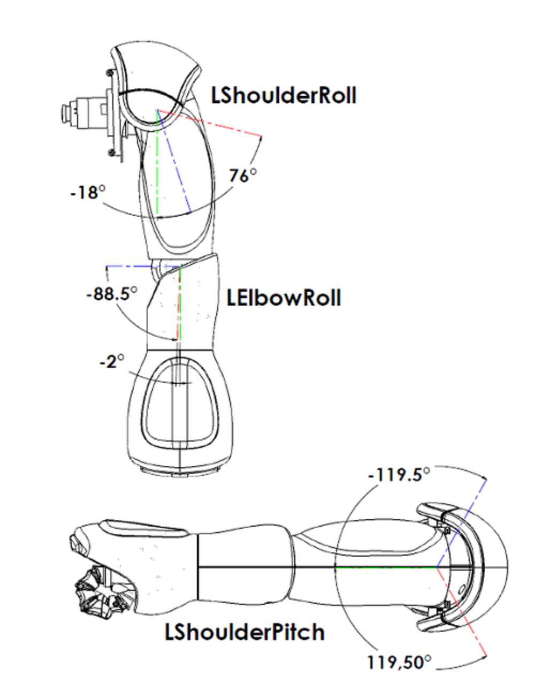
Calculating NAO’s Angles
Needed to mimic NAO’s ‘zero’ angle and subtract it.
Very “hands on”.

Slide 7
Summary
J4K Library made using Kinect super simple.
Vector math used to pull skeleton angles.
Angles translated to NAO.

Slide 8
Future Work
Legs
Kinect 2.0
Robot balance
Head rotation
Finger tracking

Slide 9

Questions?

